Slide 1
Visualizing Mathematical Physics
Ben Payne
September 2019
Audience: Ask questions as they arise rather than waiting for the end

Slide 2
Visualizing Mathematical Physics
Ben Payne

Slide 3
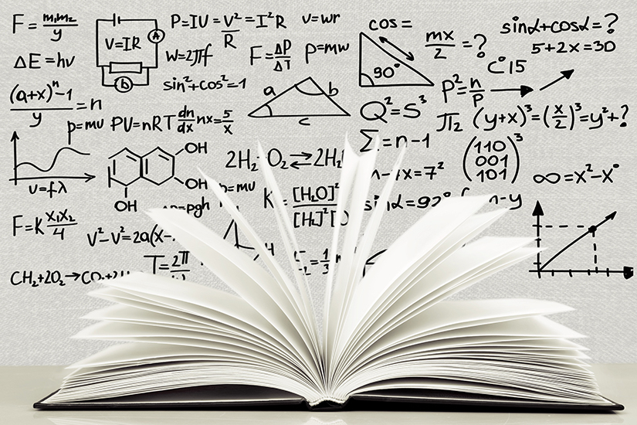
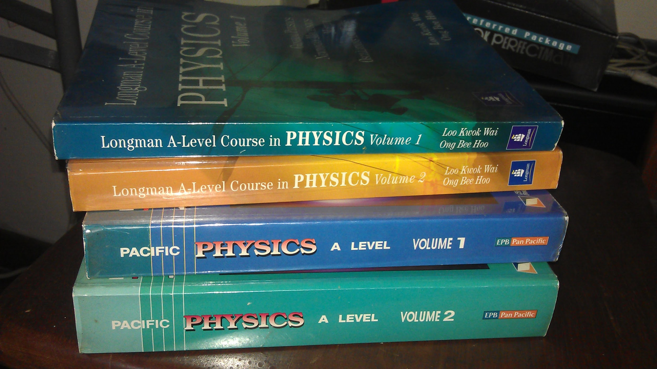

Documentation of technical knowledge
Encyclopedias
Peer-reviewed articles in journals
Text books

Slide 4
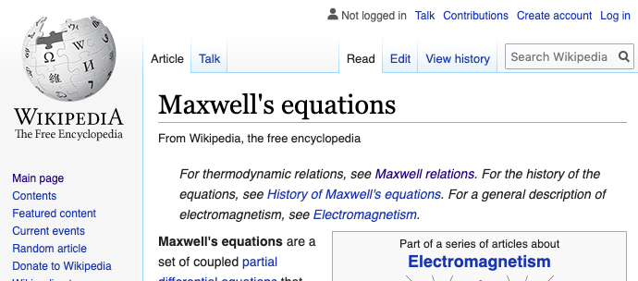
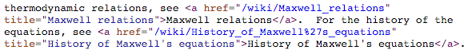
Modern revolution: hyperlinked text

Slide 5
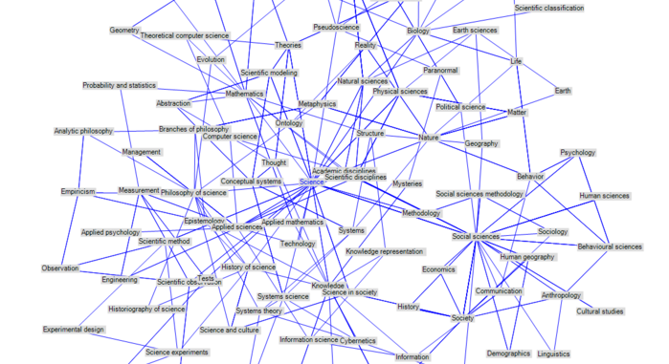
Wikipedia is different from dead tree format
Claim: a directed graph is a more intuitive representation of how information is connected.
(Also introduces novel challenges in navigating content.)
Notes:
Image source: https://en.wikipedia.org/wiki/File:Category-graph.png

Slide 6
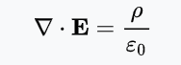
Physics is mathematical
Physics can be described in writing
"Gauss's law... relates the distribution of electric charge to the resulting electric field."
Physics can be expressed with expressions
Expressions are related formally by mathematical steps
"Multiply both sides of the expression by X"
--> Leverage that formal connectivity to construct a graph

Slide 7
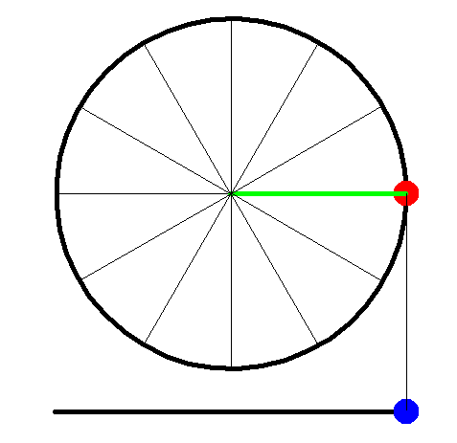

Example
“Given $ω=2πf$ and $T=\frac{1}{f}$ , then $ω=\frac{2π}{T}$ .”
What steps show this derivation?
Notes:
Animation is from
http://www.physics.uoguelph.ca/tutorials/shm/phase0.html

Slide 8
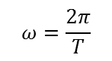
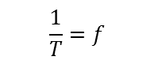
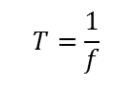
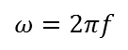
Derivation
“Given $ω=2πf$ and $T=\frac{1}{f}$ , then $ω=\frac{2π}{T}$ .”
Angular and linear frequency are related by equation 1
$$ω=2πf$$
Period and linear frequency are related by equation 2
$$T=\frac{1}{f}$$
Invert both sides of equation 2
$$\frac{1}{T}=f$$
What steps show this derivation:
Substitute equation 3 into equation 1
$$ω=\frac{2π}{T}$$
Notes:
Animation is from
http://www.physics.uoguelph.ca/tutorials/shm/phase0.html

Slide 9
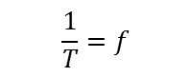
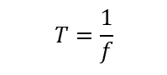
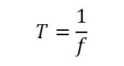
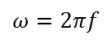
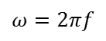

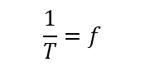

Graph representation of Derivation
Expressions are nodes on a graph
Angular and linear frequency are related by
$$ω=2πf$$
$$T=\frac{1}{f}$$
$$ω=2πf$$
Period and linear frequency are related by
$$T=\frac{1}{f}$$
$$\frac{1}{T}=f$$
Invert both sides of equation 2
$$\frac{1}{T}=f$$
Substitute equation 3 into equation 1
$$ω=\frac{2π}{T}$$
$$ω=\frac{2π}{T}$$
Problem: Graph isn’t helpful since the steps aren’t atomic
→ Need a second type of node describing steps between expressions

Slide 10
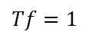
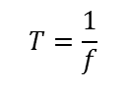
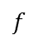
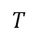

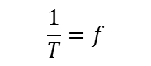
Derivation of frequency relations
declareInitialExpression
$$T=\frac{1}{f}$$
$$ω=2πf$$
multiplyBothSidesBy
$$f$$
$$Tf=1$$
$$T$$
divideBothSidesBy
Inference rules:
(True) propositions:
$$\frac{1}{T}=f$$
subEq1intoRHSofEq2
→ Now we could use a
Computer Algebra System
to check derivation (each inference rule)
$$ω=\frac{2π}{T}$$

Slide 11
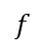
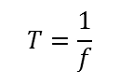
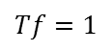
Validation per step
Claim: Any step in a derivation can be validated using a computer algebra system
def multiplyBothSidesBy(input, feed):
input_LHS, input_RHS = input.split("==")
return input_LHS * feed == input_RHS * feed
Input: "T == 1/f"
Feed: "f"
Output: "T * f == 1"
If output == multiplyBothSidesBy(input, feed)
then step is valid
$$T=\frac{1}{f}$$
multiplyBothSidesBy
$$f$$
$$Tf=1$$

Slide 12
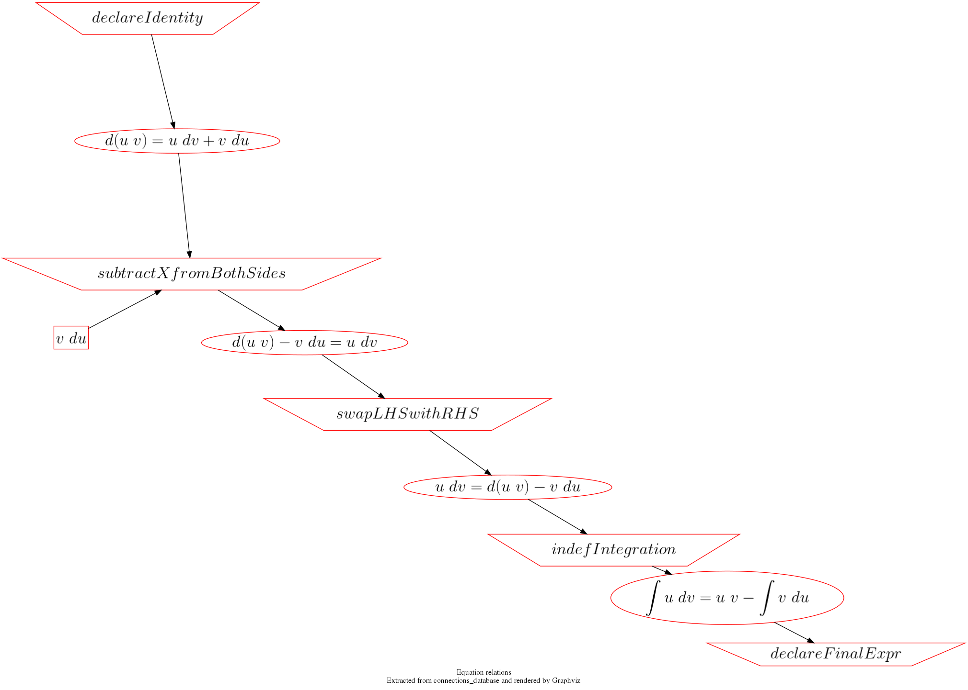
Derivation example: Integration by parts
Notes:
https://allofphysicsgraph.github.io/proofofconcept/site/derivations_generated_from_project/integration_by_parts.html
proofofconcept/site/graphviz/connections_integration_by_parts.gv
PNG files are from proofofconcept/v3_CSV/lib/images_*_png/
neato -Tpng connections_integration_by_parts.gv -o connections_integration_by_parts.png

Slide 13
What's going on (jargon)
Oval nodes = expression (equality or inequality)
trapezoid nodes = inference rules
Square nodes = feeds

Slide 14
What's going on (step 1)

Slide 15
What's going on (step 2)

Slide 16
What's going on (step 3)

Slide 17
What's going on (step 4)

Slide 18
What's going on (step 5)

Slide 19
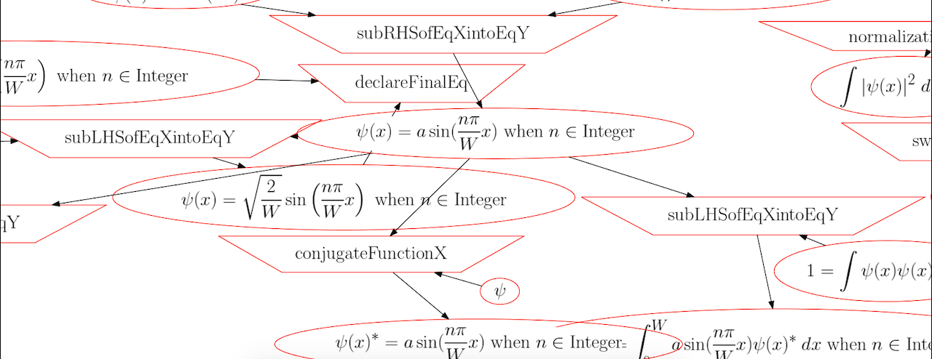
Connectivity of concepts in Physics
An expression may appear in multiple derivations
The expression appears once in the graph
Instances of Inference rules are not unique in the graph

Slide 20
Inference rules connect expressions
Mathematical physics uses a set of operators which act on expressions
"Add x to both sides"
"select the imaginary parts of the expression"
"substitute x = y into the expression"
"Apply curl to both sides of the expression"
Scope:
Algebra, calculus, differential equations, linear algebra, Dirac notation, etc

Slide 21
Enumerating (71) inference rules
indefIntegration
indefIntLHSOver
indefIntOver
indefIntRHSOver
IntOverFromTo
partialDiffWRT
raiseBothSidesToPower
ReplaceCurlWithLeviCevitaSummationContravariant
replaceScalarWithVector
ReplaceSummationNotationWithVectorNotation
RHSofExprXeqRHSofExprY
selectImagParts
selectRealParts
simplify
solveForX
subLHSofExprXintoExprY
subRHSofExprXintoExprY
subtractXfromBothSides
subXforY
sumExponents
sumExponentsLHS
sumExponentsRHS
swapLHSwithRHS
takeCurlofBothSides
Xcrossbothsidesby
Xdotbothsides
addExprXtoExprY
addXtoBothSides
addZerotoLHS
addZerotoRHS
applyDivergence
applyGradientToScalarFunction
applyOperatorToBra
applyOperatorToKet
AssumeNdimensions
bothsidescrossX
bothsidesdotX
boundaryCondition
claimExprXequalsExprY
claimLHSequalsRHS
combineLikeTerms
conjugateBothSides
conjugateFunctionX
conjugateTransposeBothSides
declareAssumption
LHSofExprXeqLHSofExprY
makeExprPower
multbothsidesby
multExprXbyExprY
multLHSbyUnity
multRHSbyUnity
normalizationCondition
declareFinalExpr
declareGuessSolution
declareIdentity
declareInitialExpr
differentiateWRT
distributeConjugateToFactors
distributeConjugateTransposeToFactors
dividebothsidesby
EvaluateDefiniteIntegral
expandIntegrand
expandLHS
expandMagnitudeToConjugate
expandRHS
ExprXisTrueUnderconditionExprY
factorOutX
factorOutXfromLHS
factorOutXfromRHS
functionIsEven
functionIsOdd
This list is incomplete
Notes:
cat proofofconcept/v3_CSV/databases/inference_rules_database.csv | cut -d',' -f1 | tr -d ' ' | sed '/^$/d' | sort --ignore-case

Slide 22
Summary of the essential concepts
Expressions: mathematical equalities or inequalities; each node is unique
Inference rules: what action is applied to or generates an expression; may have additional arguments ("feed"); node is not unique
Edges connect Expressions and Feeds to Inference rules
Node types alternate between Expressions and Inference rules
Each step is an inference rule with expressions as inputs and outputs
Steps can be checked for correctness by a computer algebra system
Steps form a graph

Slide 23
Has this been already done?
Not that I can find, though maybe in a proprietary database?
Mathematica – commercial computer algebra system
https://www.symbolab.com/ -- subscription based
Can it be commercialized?
https://www.facebook.com/Equationmap -- now defunct
http://formula-database.com/ -- now defunct
--> Graph structure is not required for these products, so probably not

Slide 24
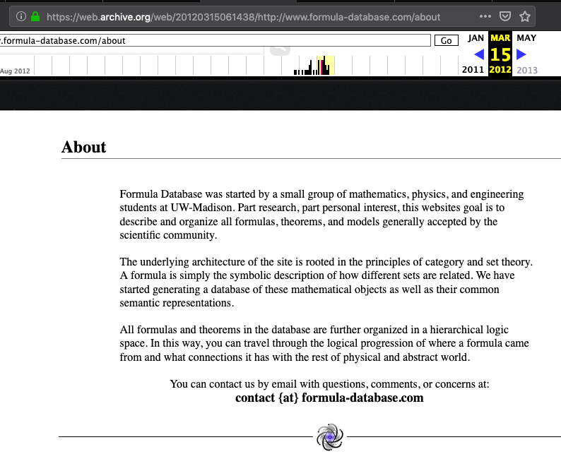
Formula-database

Slide 25
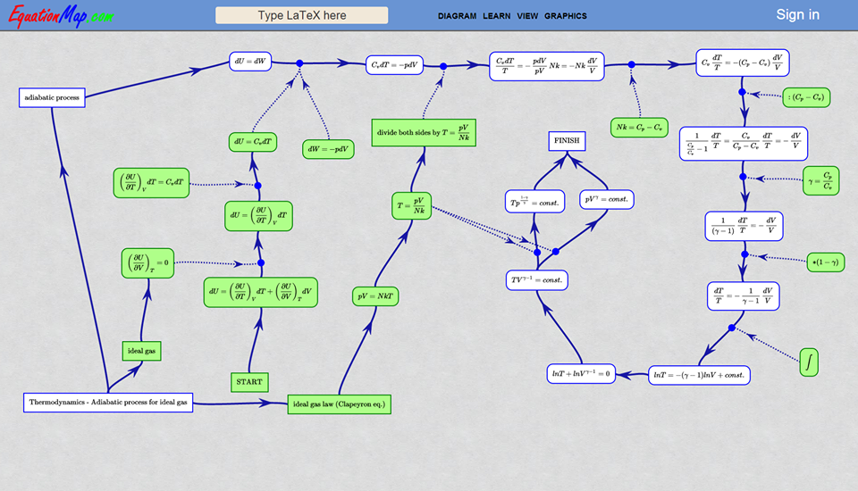
EquationMap.com (defunct)

Slide 26
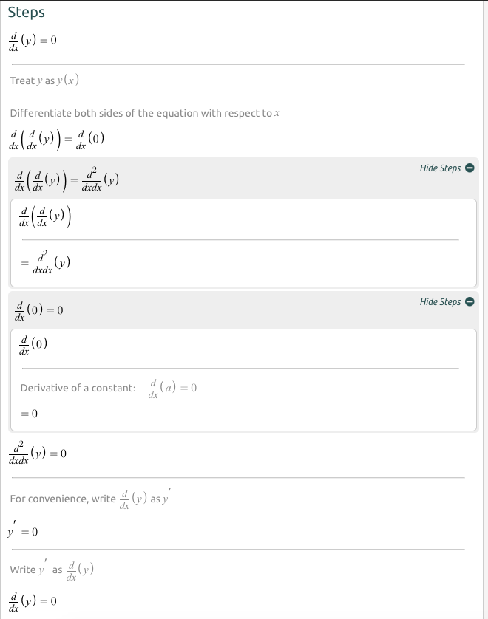
Symbolab.com (active)
Linear presentation of derivation steps
https://www.symbolab.com/solver/step-by-step/
implicit%20derivative%20%5Cfrac%7Bdy%7D%7Bdx%7D%2C%20%20

Slide 27
Licensing and cost for Physics Derivation Graph
Creative Commons Attribution 4.0 International License
Content and software is primarily created by Ben in his spare time
Hosting is free. Access is open. Code is available on Github

Slide 28
PDG is backwards compatible: Generate a PDF from Derivation Graph
Derivations in the Physics Derivation Graph can be non-linear
The steps can be converted to conventional sequential layout in a Latex document

Slide 29
Outline
Overview of core concept
Use cases
Challenge: Evaluating options for computer algebra systems
Challenge: Visualizing the Physics Derivation Graph
Project status
In this section: who is the audience?

Slide 30

Use case: Physics students
Supplement the
history-based
linear progression
Understand relations
between concepts
Allow for different
entry points into topics
Notes:
http://himpax.com/wp-content/uploads/2015/11/frustration.jpg
* use cases
** Physics students understand relations between concepts. (Current paradigm is a course per topic.)
** Where does math get used and how? --> Inference rules
** Journal articles validation, relation
** where is the edge of research?

Slide 31

Use case: Math students
Where does this stuff
get used?
Notes:
https://www.sacfcu.com/blog/wp-content/uploads/2014/03/lady-balancing-checkbook.jpg
* use cases
** Physics students understand relations between concepts. (Current paradigm is a course per topic.)
** Where does math get used and how? --> Inference rules
** Journal articles validation, relation
** where is the edge of research?

Slide 32

Use case: Teachers
What have students covered in previous courses?
What is covered in this course?
What comes in future courses?
Where's the frontier?

Slide 33

Use case: Researchers
Clearly delineated knowledge boundary
Collaborative indication of who is working on what
Potential to serve as collaborative platform
Documentation of derivation to be published
Ability to validate published derivations
Avoid human text processing bottleneck

Slide 34
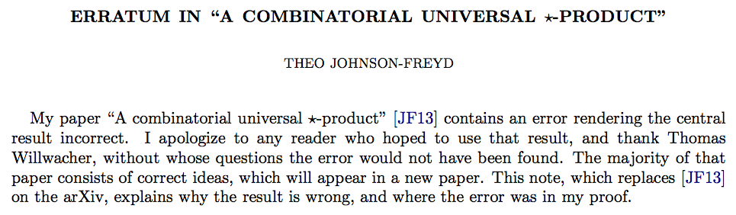
Use case: Journal articles
Validation of Math
Clearer relation between topics beyond citations
Mistake
Notes:
Antigravity hyperdrive
http://arxiv.org/pdf/gr-qc/0604076v1.pdf
This Time - Gibbs
http://www.vixra.org/pdf/0907.0001v1.pdf
ERRATUM IN “A COMBINATORIAL UNIVERSAL PRODUCT”
http://arxiv.org/pdf/1307.2940v3.pdf
https://mathoverflow.net/questions/46251/submission-of-a-paper-with-a-serious-error-to-a-good-journal
https://mathoverflow.net/questions/65090/downsides-of-using-the-arxiv
* use cases
** Physics students understand relations between concepts. (Current paradigm is a course per topic.)
** Where does math get used and how? --> Inference rules
** Journal articles validation, relations between papers
** where is the edge of research?

Slide 35
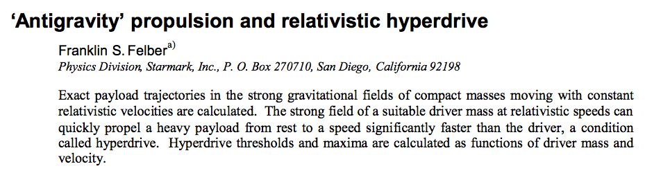
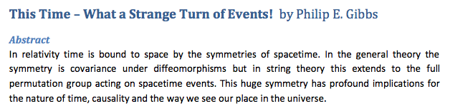
Use case: distinguishing legitimate advancements
Crackpot or real?
Notes:
Antigravity hyperdrive
http://arxiv.org/pdf/gr-qc/0604076v1.pdf
This Time - Gibbs
http://www.vixra.org/pdf/0907.0001v1.pdf
ERRATUM IN “A COMBINATORIAL UNIVERSAL PRODUCT”
http://arxiv.org/pdf/1307.2940v3.pdf
https://mathoverflow.net/questions/46251/submission-of-a-paper-with-a-serious-error-to-a-good-journal
https://mathoverflow.net/questions/65090/downsides-of-using-the-arxiv
* use cases
** Physics students understand relations between concepts. (Current paradigm is a course per topic.)
** Where does math get used and how? --> Inference rules
** Journal articles validation, relations between papers
** where is the edge of research?

Slide 36
Outline
Overview of core concept
Use cases
Challenge: Evaluating options for computer algebra systems
Challenge: Visualizing the Physics Derivation Graph
Project status
In this section: seemingly simple questions lead to interdependent options

Slide 37
Reminder: How to validate steps
An inference rule is the atomic step of logic that relates two mathematical expressions
Computer Algebra Systems are capable of validating steps
Caveat: simply carrying out mathematical manipulations of expressions does not necessarily lead to physically valid outcomes.

Slide 38
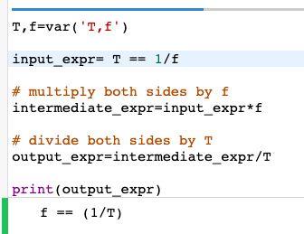
Operations on Expressions in Sage
Angular and linear frequency are related by equation 1
$$ω=2πf$$
Period and linear frequency are related by equation 2
$$T=\frac{1}{f}$$
Invert both sides of equation 2
$$\frac{1}{T}=f$$
Substitute equation 3 into equation 1
$$ω=\frac{2π}{T}$$

Slide 39
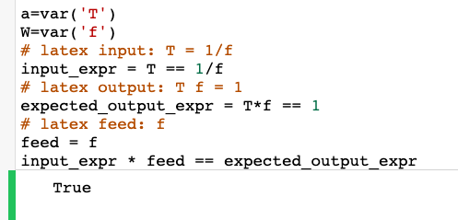
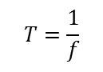
Validating a derivation step using Sage
$$T=\frac{1}{f}$$
multiplyBothSidesBy
$$f$$
$$Tf=1$$

Slide 40
Survey of candidate Computer Algebra Systems
Starting point: https://en.wikipedia.org/wiki/List_of_computer_algebra_systems
Evaluation criteria:
Free vs Not Free: free improves accessibility
Most of the Free CAS are also open source, though not all
Of the Free and Open Source CAS,
How intuitive is the setup? Is the interface intuitive?
Choosing a CAS constrains who is likely to contribute to the Physics Derivation Graph
Does the CAS support the scope of operations relevant to the Physics Derivation Graph?
--> Need a way to compared CAS expressiveness

Slide 41
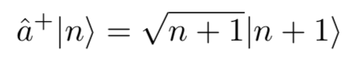
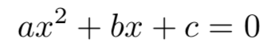
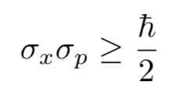
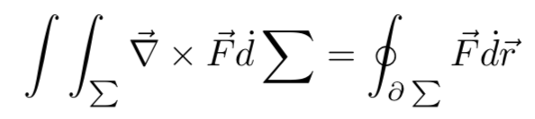
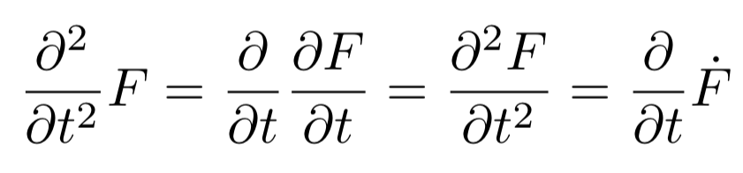
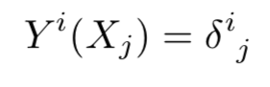
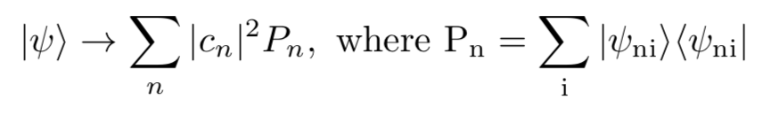
Expression test cases
Creation operator
Second order polynomial
Uncertainty principle
Stoke's Theorem
Partial differentiation
Einstein notation
Luder's Projection

Slide 42
Expression Representation choices
Rendering
Latex – (+) widely used; (-) can create non-sense input; (-) can create underspecified expressions. (20 characters for polynomial test case)
Presentation MathML (324 characters for polynomial test case)
Content MathML (381 characters for polynomial test case)
CAS
Sympy – (+) open source, (+) free, (+) Python based
Sage – (+) open source, (+) free,
Mathematica – (-) closed source, (-) not free
Could try to make lossless conversions between representations

Slide 43
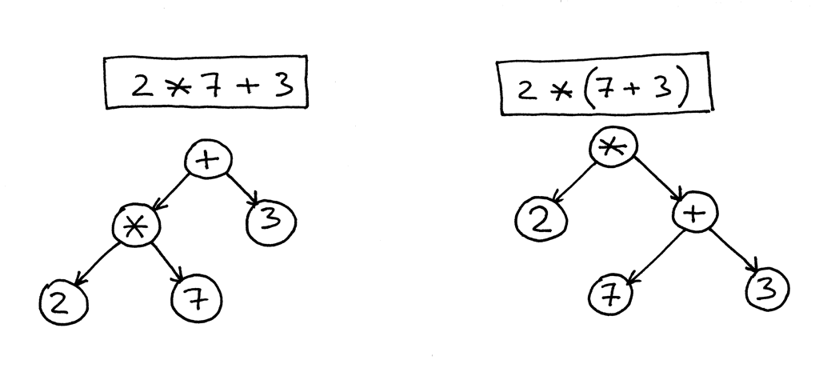
Universal representation: Abstract Syntax Tree
Rather than be constrained to a specific language or presentation method, what matters is the AST
Input LaTeX, generate parse tree, then AST, then transform into language-specific format
source
http://mathlex.org/doc/how-mathlex-works
J. Stuber and M. van den Brand, Extracting Mathematical Semantics from LATEX Documents, 2003
R. J. Fateman and E. Caspi, Parsing TEX into Mathematics, 1999
Notes:
https://stackoverflow.com/questions/5967888/whats-the-difference-between-parse-trees-and-abstract-syntax-trees

Slide 44
Summary of Computer Algebra System survey
I don't have deep experience with all relevant options to say what the best choice is; I've used Sage for proof of concept examples. Current implementation uses SymPy
User input method is LaTeX; conversion to AST enables agnosticism; can convert to Content MathML

Slide 45
Outline
Overview of core concept
Use cases
Challenge: Evaluating options for computer algebra systems
Challenge: Visualizing the Physics Derivation Graph
Project status
In this section: Is visualization helpful? Necessary? How do the answers depend on scale?

Slide 46
Graph representations of steps
Directed graph with three types of nodes: expressions, inference rules, feeds
Goals:
Visualize and navigate structure
Serve as input method (rather than command line or form based)
Options include
Resource Description Framework (RDF) subject–predicate–object
GraphViz
Neo4j – property graph nodes and edges have attributes
D3js
NetworkX

Slide 47
Demo of d3js

Slide 48
Analysis of Alternatives for graphs
D3js
Free
Javascript library for Browser-based rendering
Visualization of JSON; no query
Graphviz
Free
Static PNGs or SVGs from specially formatted DOT input files
No query language
Neo4j
Free
Proprietary property graph with proprietary query language Cypher
Limited visualization in browser
Integrates with Python
Complex queries unnecessary for PDG
RDF
Free
No visualization method
Enabling complex queries is not useful for PDG
step 1 | has input | y=mx+b step 1 | has inference rule | multiply both sides by step 1 | has feed | 2 step 1 | has output | 2*y = 2*m*x + 2*b

Slide 49
Outline
Overview of core concept
Use cases
Challenge: Evaluating options for computer algebra systems
Challenge: Visualizing the Physics Derivation Graph
Project status
In this section: why is this challenging?

Slide 50
Current status of Physics Derivation Graph
879 expressions stored as Latex in 39 derivations
Latex to PNG
Front end: Python Flask web interface
Graphviz for visualization
Back end: JSON for Latex and Inference rules
Python 3 to generate Graphviz and interface with JSON and Flask
Docker container for portability
Use of SymPy for validation of steps and dimensional consistency
Notes:
Number of expressions:
cat proofofconcept/v3_CSV/databases/expressions_database.csv | wc -l
242
Number of derivations:
cat proofofconcept/v3_CSV/databases/connections_database.csv | cut -d',' -f1 | sort | uniq | wc -l
16
15*16 = 240, so an average of 16 expressions per derivation
Number of steps:
$ cat connections_database.csv | cut -d',' -f1,2 | sort | uniq | wc -l
217

Slide 51
Challenges for Physics Derivation Graph
There's more than a lifetime of work.
Collaboration on PDG software is needed
Manual entry by Physicists?
Standardized notation is needed
Balance between presentation (e.g., Latex), verification (CAS), and input (not MathML)
Scalability of visualizing >10 nodes (400 nodes being a visual limit)
Navigability of graph representation (zoom in/out, pan)

Slide 52
Why progress takes a long time
Identify issue
Brainstorm options and survey what technologies are applicable
Form a sufficiently informed opinion on each option that I am willing to invest creating an architecture based on the selection
Build the solution
Identify whether the issues with my selection are due to my lack of understanding, insufficient skills, or I made the wrong selection
Gain additional skills
Re-survey the options with my new knowledge and experience
Rebuild the implementation with a different selection of technologies
Progress should be sustainable; also need to avoid burnout

Slide 53
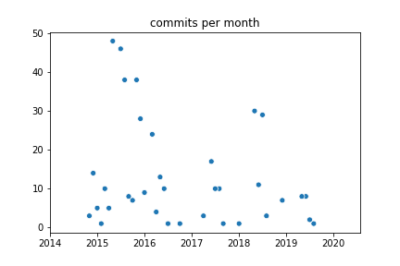
Git commit activity for https://github.com/allofphysicsgraph/proofofconcept

Slide 54
Skills that are relevant
Working experience with mathematical physics at graduate level
Python
HTML, CSS, Javascript (MathJax, D3JS)
Abstract syntax trees
Computer algebra systems: Mathematica, Sage,
Latex, MathML, RDF
CSVs, SQL
Graph creation and visualization (Neo4j, Graphviz)
Write documentation
Collaborate with other people
Have a job that makes money and doesn't take up too much time
Set boundaries on scope
Track multiple tasks and dependencies; prioritize tasks

Slide 55

Scaling faster than manual input
Bulk Latex for arxiv.org is available in an AWS S3 bucket
The full 1TB dataset decompresses to 4TB. The manifest is a 1MB XML file.
There's a freely accessible subset from Cornell
Analysis of 17MB hep-th-2003: 29,481 Latex expressions
--> 1.7B Latex expressions assuming linear scaling

Slide 56
Is this effort the work of a crank?
http://math.ucr.edu/home/baez/crackpot.html
I'm not advocating new physics. The Physics Derivation Graph is merely a way of documenting content

Slide 57
Source code
https://github.com/allofphysicsgraph/proofofconcept
Documentation
https://derivationmap.net
https://physicsderivationgraph.blogspot.com
Channels
https://groups.google.com/g/physics-derivation-graph
https://www.youtube.com/channel/UCBSInUAbtBkYDYKNc_iauVQ
Questions?

Slide 58
Source code
https://github.com/allofphysicsgraph/proofofconcept -- in use Nov 2014 to current
https://code.google.com/archive/p/physics-equations-graph/ -- in use Aug 2011 to Nov 2014
Documentation
https://github.com/allofphysicsgraph/proofofconcept/wiki
https://allofphysicsgraph.github.io/proofofconcept/site/derivations.html
https://physicsderivationgraph.blogspot.com -- starts in Sept 2015
https://github.com/allofphysicsgraph/proofofconcept/blob/gh-pages/doc/physics_graph_notes.log -- starts in Oct 2012
Questions?

Slide 59
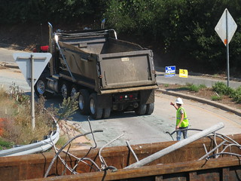
Backup slides

Slide 60
What about text or hyperlink annotations?
Additional node types could contain hyperlinks to external text resources
Text explaining the step (or steps) could be included

Slide 61
Mechanics of Implementation
1 of 3
Three type of nodes; each node contains either Latex or text
Inference rules can appear multiple times, so they need a unique identifier to distinguish nodes.
Feed nodes are Latex. They can appear multiple times in the graph, so they also need a unique identifier
An expression can be rendered in multiple representations (e.g. MathML, Latex, Sage), so a unique identifier is needed
An expression can appear multiple times in a derivation. Therefore, an index unique to that step is needed.

Slide 62
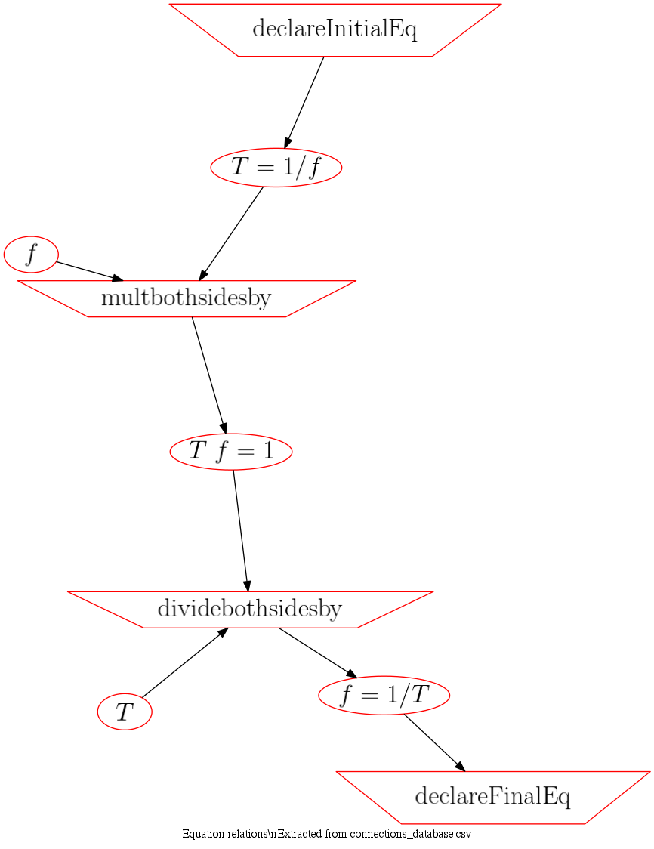
Building the visual graph
2 of 3

Slide 63
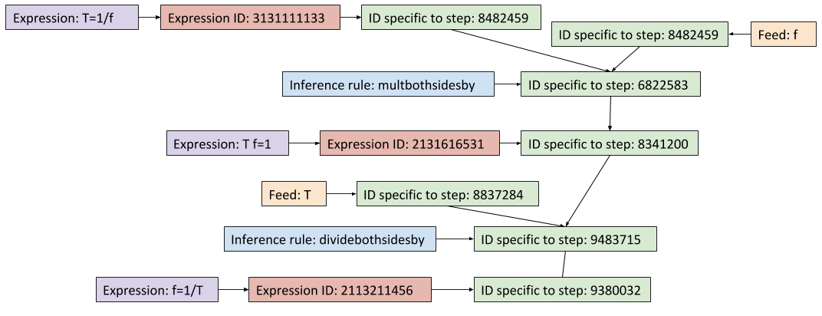
Building the visual graph means tracking indices
3 of 3

Slide 64
Domains not described by expressions
Geometry is not in scope
Mathematical proofs

Slide 65
Physics Derivation Graph is not
PDG is not a mind map
PDG is not a tree-based structure

Slide 66
Database options explored
Single CSV
CSV per derivation
XML
SQL

Slide 67





Notes:
You have been exposed to advanced Physics concepts through pop culture
** Schrodinger's cat
** Quantum Mechanics
** String Theory

